Slide 1






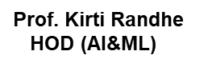


ISB&M College of Engineering, Pune

Slide 2
AI for Cybersecurity
Protecting sensitive information and assets

Slide 3

Protecting sensitive information and assets
Securing User Authentication
Fraud Prevention with Cloud AI Solutions

Slide 4
Securing User Authentication
Authentication abuse prevention
Account reputation scoring
User authentication with keystroke recognition
Biometric authentication with facial recognition

Slide 5

Fraud Prevention with Cloud AI Solutions
leverage machine learning (ML) algorithms for fraud detection
bagging and boosting techniques can improve an algorithm’s
effectiveness.

Slide 6
sensitive information and assets
sensitive information
personally identifiable information (PII)
Financial information
Confidential business information
Trade secrets
Assets
Servers
Databases
Networks

Slide 7

Securing User Authentication
User authentication is a critical aspect of cybersecurity that involves verifying the identity of a user or system before allowing access to sensitive information or assets.
Effective user authentication helps prevent unauthorized access and protect against cyber threats

Slide 8

Authentication abuse prevention
Authentication abuse prevention is the process of implementing security measures to prevent attackers from exploiting authentication mechanisms to gain unauthorized access to systems, applications, or data.
Authentication abuse can occur when attackers use a variety of techniques to bypass authentication controls, such as password cracking, brute-force attacks, or social engineering
To prevent authentication abuse, organizations can implement the following security measures:
Account reputation scoring
User authentication with keystroke recognition
Biometric authentication with facial recognition

Slide 9
Account reputation scoring
Account reputation scoring is a technique used in cybersecurity to assess the reputation of a user or account based on their past behavior and activities.
Account reputation scoring can be used to identify and prevent potential security threats, such as account takeover, fraud, and phishing.

Slide 10
Account reputation scoring works by analyzing a variety of factors related to a user or account, including:
Login history: This includes the frequency of logins, the devices used to log in, and the location of logins.
User behavior: This includes the types of activities performed by the user, such as the frequency and duration of sessions, the applications and services accessed, and the data and resources accessed.
Network behavior: This includes the types of traffic generated by the user, such as the volume and frequency of data transfers, the types of protocols used, and the sources and destinations of traffic.
Security incidents: This includes any security incidents or breaches associated with the user or account, such as password resets, failed login attempts, or suspicious activity.

Slide 11
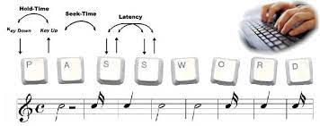
User authentication with keystroke recognition
Keystroke recognition is a biometric authentication technique used in cybersecurity that analyzes the way a user types on a keyboard to verify their identity. Keystroke recognition can be used as an additional layer of security in multi-factor authentication (MFA) systems.
Keystroke recognition works by analyzing the timing, speed, and rhythm of a user's keystrokes to create a unique typing profile. The typing profile can be used to verify the user's identity when they log in to a system or application.
Keystroke recognition works by analyzing the timing, speed, and rhythm of a user's keystrokes to create a unique typing profile. The typing profile can be used to verify the user's identity when they log in to a system or application.

Slide 12
Multi-factor authentication (MFA)
Multi-factor authentication (MFA) is a security technique used in cybersecurity to require users to provide multiple forms of identification to access a system, application, or data. MFA is an effective way to improve the security of user authentication and prevent unauthorized access to sensitive information and assets.
MFA works by requiring users to provide at least two of the following factors to verify their identity:
Something the user knows: This includes passwords, PINs, or security questions that only the user knows the answer to.
Something the user has: This includes physical objects such as security tokens, smart cards, or mobile phones that generate one-time passwords (OTPs).
Something the user is: This includes biometric factors such as fingerprints, facial recognition, or voice recognition.

Slide 13
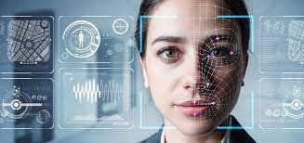
Biometric authentication with facial recognition
Biometrics are body measurements and calculations related to human characteristics
Facial recognition is a biometric authentication technique used in cybersecurity that analyzes the unique characteristics of a person's face to verify their identity. Facial recognition can be used as an additional layer of security in multi-factor authentication (MFA) systems.
Facial recognition works by capturing an image or video of a person's face and analyzing the facial features to create a unique biometric profile. The biometric profile can then be used to verify the person's identity when they log in to a system or application.

Slide 14
Biometric authentication with facial recognition
Enrollment: The user is asked to capture an image or video of their face to create a biometric profile. During enrollment, the system analyzes the unique facial features of the user, such as the distance between the eyes, the shape of the nose, and the contours of the face, to create a biometric template.
Authentication: When the user logs in to the system or application, the facial recognition system captures an image or video of their face and compares it to their enrolled biometric profile. The system calculates a similarity score between the two images and if the similarity score meets a certain threshold, the user is granted access to the system or application.
Facial recognition can be used as an additional layer of security in multi-factor authentication (MFA) systems, along with other authentication methods such as facial recognition, It can be vulnerable to attacks such as spoofing or deepfake attacks

Slide 15
Fraud Prevention with Cloud AI Solutions
Cloud-based AI solutions can be used to prevent fraud in cybersecurity by analyzing vast amounts of data and identifying patterns that are indicative of fraudulent activity. Fraud detection is an important aspect of cybersecurity, particularly for financial institutions and e-commerce platforms that process large volumes of transactions.
Cloud-based AI solutions for fraud prevention can be customized to the specific needs of an organization, and can be trained on large amounts of historical data to improve accuracy over time. Additionally, cloud-based solutions are scalable, allowing organizations to quickly adapt to changes in their transaction volumes and fraud prevention needs

Slide 16
Cloud-based AI solutions for fraud prevention typically involve the following steps
Data collection: Cloud-based AI solutions collect data from various sources such as transaction records, customer profiles, and behavior logs.
Data preprocessing: The collected data is preprocessed to eliminate redundant and irrelevant information, and to transform it into a format that can be analyzed by the AI algorithms.
AI analysis: Cloud-based AI solutions use machine learning algorithms such as anomaly detection and predictive modeling to analyze the preprocessed data and identify patterns that are indicative of fraudulent activity.
Fraud prevention: Once the AI algorithms have identified fraudulent activity, the cloud-based solution can take action to prevent it, such as blocking suspicious transactions, alerting fraud prevention teams, or updating fraud detection algorithms to improve accuracy.

Slide 17

leverage machine learning (ML) algorithms for fraud detection
Machine learning (ML) algorithms can be leveraged for fraud detection in cybersecurity by analyzing large volumes of data and identifying patterns that are indicative of fraudulent activity. ML algorithms can be used to learn from historical data to improve fraud detection accuracy over time, and can be customized to the specific needs of an organization.

Slide 18
Improved threat detection
Real-time response
Adaptability
Reduced false positives
Improved user authentication
Reduced workload for security teams

Slide 19
The evolution of technology allows us to make use of Machine Learning (ML), the science of creating and applying algorithms that are capable of learning from the past, to prevent and detect fraud. These are the first steps to secure data, people, and organizations.
In this strategy of prevention and detection, Machine Learning mainly creates identification models from previously collected data to define profiles of usage. This approach provides a combination of solutions adapted to your business to secure users’ digital identities and the computing resources of the company
But how does this apply in practice to detect fraud?
Definition of intelligent profiles
intelligent profiles are created with ML and are defined with normal usage. If the user’s behaviors are considered unusual or do not map with existing data, are then considered potential frauds and actions are made to prevent any issue.
Creation of algorithms
Machine Learning creates algorithms based on collected data from users’ journeys (or users’ activity in the usage of apps or services). Through that, the algorithms learn and can distinguish between fraudulent operations and legitimate ones without raising the suspicions of those executing the transactions
Detect and block dangerous behaviors
The process of fraud prevention through Machine Learning is based on the detection, report and action in response to risks that might threaten the security of platforms and apps. The system prevents reputational damages and monetary losses by analyzing algorithms and intelligent profiles.

Slide 20

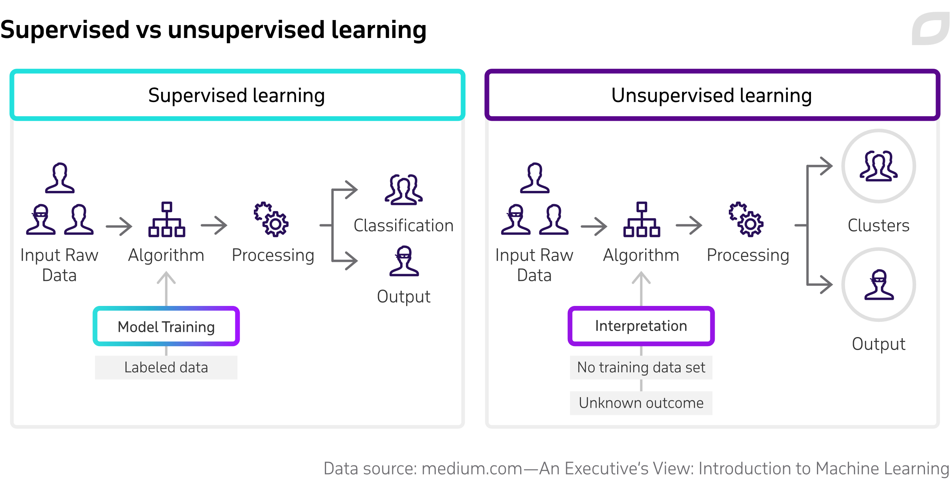

Slide 21
bagging and boosting techniques can improve an algorithm’s effectiveness
Bagging
Bootstrap Aggregating, also known as bagging, is a machine learning ensemble meta-algorithm designed to improve the stability and accuracy of machine learning algorithms used in statistical classification and regression. It decreases the variance and helps to avoid overfitting. It is usually applied to decision tree methods. Bagging is a special case of the model averaging approach.

Slide 22
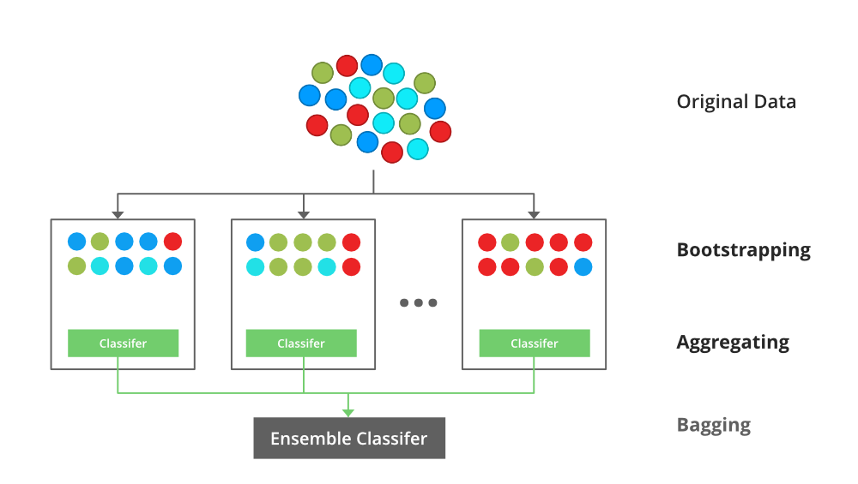
Implementation Steps of Bagging
Step 1: Multiple subsets are created from the original data set with equal tuples, selecting observations with replacement.
Step 2: A base model is created on each of these subsets.
Step 3: Each model is learned in parallel with each training set and independent of each other.
Step 4: The final predictions are determined by combining the predictions from all the models

Slide 23
Bagging is also used in cybersecurity to improve the accuracy and robustness of machine learning models that are used for various security applications. In cybersecurity, bagging can be used for tasks such as intrusion detection, malware detection, and spam filtering. For example, in intrusion detection systems (IDS), bagging can be used to improve the accuracy of anomaly detection models. Anomaly detection models aim to identify unusual patterns of behavior in network traffic that could indicate a potential intrusion. By using bagging to train multiple anomaly detection models, we can reduce the variance of the individual models and improve the overall detection accuracy. Similarly, in malware detection, bagging can be used to improve the accuracy of models that classify files as malicious or benign. By training multiple models on different subsets of the training dataset, we can reduce the risk of overfitting and improve the generalization ability of the model. Overall, bagging is a useful technique in cybersecurity that can help improve the accuracy and robustness of machine learning models used for various security tasks.

Slide 24
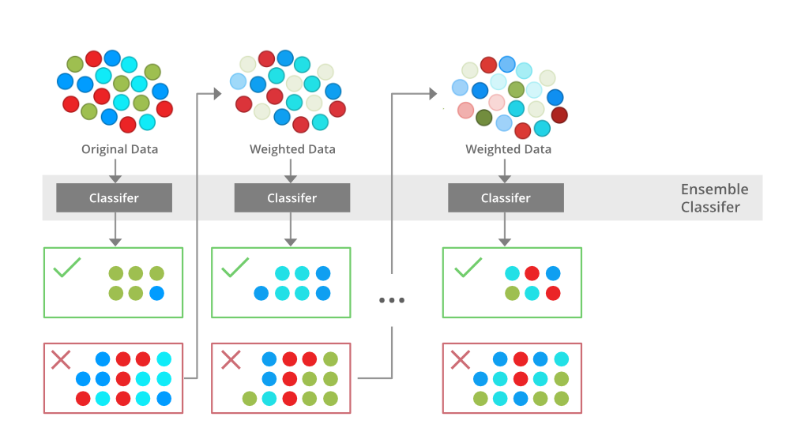
Boosting
Boosting is an ensemble modeling technique that attempts to build a strong classifier from the number of weak classifiers. It is done by building a model by using weak models in series. Firstly, a model is built from the training data. Then the second model is built which tries to correct the errors present in the first model. This procedure is continued and models are added until either the complete training data set is predicted correctly or the maximum number of models is added.

Slide 25
Boosting is another machine learning ensemble technique used in cybersecurity to improve the accuracy of machine learning models. In boosting, a sequence of models is trained, where each subsequent model is trained to correct the errors made by the previous model. The final prediction is obtained by aggregating the predictions of all the models, typically by weighted averaging.
Boosting can be used in cybersecurity for various tasks such as intrusion detection, spam filtering, and malware detection. For example, in intrusion detection systems, boosting can be used to improve the accuracy of classification models that distinguish between normal and abnormal network traffic. By iteratively training a sequence of models to focus on the harder-to-classify examples, we can improve the overall accuracy of the system.
Similarly, in spam filtering, boosting can be used to improve the accuracy of models that classify emails as spam or non-spam. By focusing on the harder-to-classify examples, we can improve the precision and recall of the spam filter. In malware detection, boosting can be used to improve the accuracy of models that classify files as malicious or benign. By iteratively training a sequence of models to focus on the more challenging samples, we can improve the overall accuracy of the system. Overall, boosting is a useful technique in cybersecurity that can help improve the accuracy and robustness of machine learning models used for various security tasks. However, it is important to note that boosting can sometimes lead to overfitting, especially if the individual models are too complex or if the training dataset is too small.

Slide 26
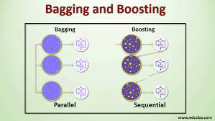
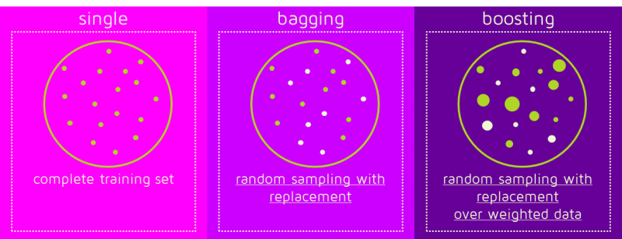

Slide 27


